Slide 1
23
Multithreading

Slide 2
Do not block the way of inquiry.
  Charles Sanders Peirce
A person with one watch knows what time it is; a person with two watches is never sure.
  Proverb
Learn to labor and to wait.
  Henry Wadsworth
  Longfellow
The most general definition of beauty... Multeity in Unity.
  Samuel Taylor Coleridge
The world is moving so fast these days that the man who says it can’t be done is generally interrupted by someone doing it.
— Elbert Hubbard

Slide 3
OBJECTIVES
In this chapter you will learn:
What threads are and why they are useful.
How threads enable you to manage concurrent activities.
The life cycle of a thread.
Thread priorities and scheduling.
To create and execute Runnables.
Thread synchronization.
What producer/consumer relationships are and how they are implemented with multithreading.
To display output from multiple threads in a Swing GUI.
About Callable and Future.

Slide 4
23.1 Introduction
23.2 Thread States: Life Cycle of a Thread
23.3 Thread Priorities and Thread Scheduling
23.4 Creating and Executing Threads
23.5 Thread Synchronization
23.6 Producer/Consumer Relationship without Synchronization
23.7 Producer/Consumer Relationship with Synchronization
23.8 Producer/Consumer Relationship: Circular Buffer
23.9 Producer/Consumer Relationship: ArrayBlockingQueue
23.10 Multithreading with GUI
23.11 Other Classes and Interfaces in java.util.concurrent
23.12 Monitors and Monitor Locks
23.13 Wrap-Up

Slide 5
23.1 Introduction
Multithreading
  Provides application with multiple threads of execution
  Allows programs to perform tasks concurrently
  Often requires programmer to synchronize threads to function correctly

Slide 6
Performance Tip 23.1
A problem with single-threaded applications is that lengthy activities must complete before other activities can begin. In a multithreaded application, threads can be distributed across multiple processors (if they are available) so that multiple tasks are performed concurrently and the application can operate more efficiently. Multithreading can also increase performance on single-processor systems that simulate concurrency—when one thread cannot proceed, another can use the processor.

Slide 7
Portability Tip 23.1
Unlike languages that do not have built-in multithreading capabilities (such as C and C++) and must therefore make nonportable calls to operating system multithreading primitives, Java includes multithreading primitives as part of the language itself and as part of its libraries. This facilitates manipulating threads in a portable manner across platforms.

Slide 8
23.2 Thread States: Life Cycle of a Thread
Thread states
  new state
    New thread begins its life cycle in the new state
    Remains in this state until program starts the thread, placing it in the runnable state
  runnable state
    A thread in this state is executing its task
  waiting state
    A thread transitions to this state to wait for another thread to perform a task

Slide 9
23.2 Thread States: Life Cycle of a Thread
Thread states
  timed waiting state
    A thread enters this state to wait for another thread or for an amount of time to elapse
    A thread in this state returns to the runnable state when it is signaled by another thread or when the timed interval expires
  terminated state
    A runnable thread enters this state when it completes its task

Slide 10
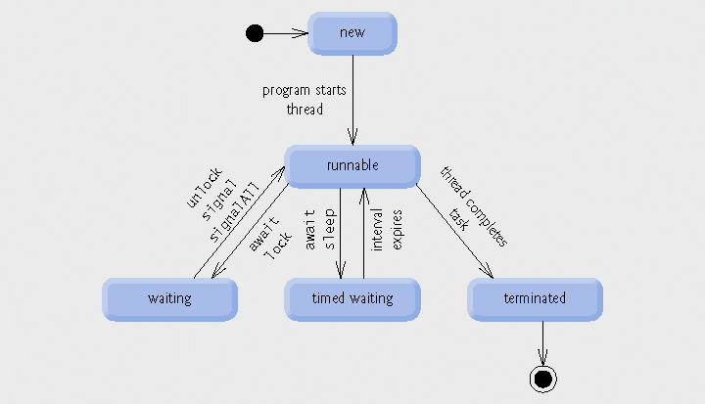
Fig. 23.1 | Thread life-cycle UML state diagram.

Slide 11
23.2 Thread States: Life Cycle of a Thread
Operating system view of runnable state
  ready state
    A thread in this state is not waiting for another thread, but is waiting for the operating system to assign the thread a processor
  running state
    A thread in this state currently has a processor and is executing
  A thread in the running state often executes for a small amount of processor time called a time slice or quantum before transitioning back to the ready state

Slide 12
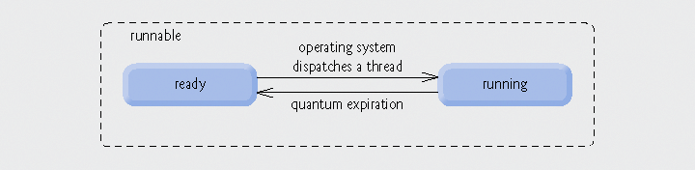
Fig. 23.2 | Operating system’s internal view of Java’s runnable state.

Slide 13
23.3 Thread Priorities and Thread Scheduling
Priorities
  Every Java thread has a priority
  Java priorities are in the range between MIN_PRIORITY (a constant of 1) and MAX_PRIORITY (a constant of 10)
  Threads with a higher priority are more important and will be allocated a processor before threads with a lower priority
  Default priority is NORM_PRIORITY (a constant of 5)

Slide 14
23.3 Thread Priorities and Thread Scheduling
Thread scheduler
  Determine which thread runs next
  Simple implementation runs equal-priority threads in a round-robin fashion
  Higher-priority threads can preempt the currently running thread
  In some cases, higher-priority threads can indefinitely postpone lower-priority threads which is also known as starvation

Slide 15
Portability Tip 23.2
Thread scheduling is platform dependent—an application that uses multithreading could behave differently on separate Java implementations.

Slide 16
Portability Tip 23.3
When designing applets and applications that use threads, you must consider the threading capabilities of all the platforms on which the applets and applications will execute.

Slide 17
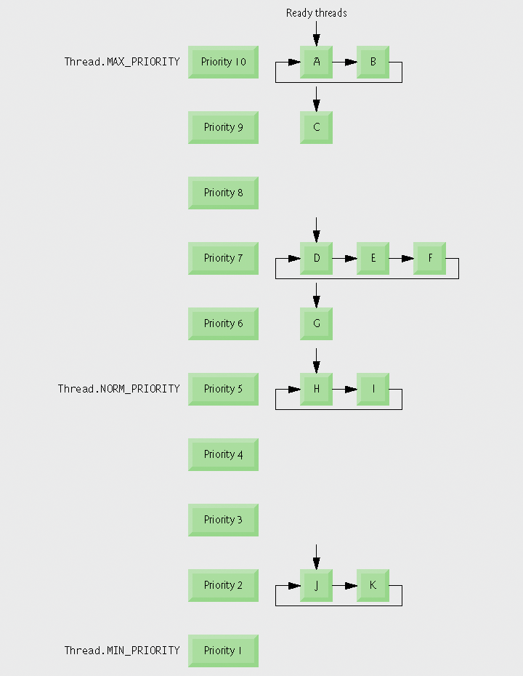
Fig. 23.3 | Thread-priority scheduling.

Slide 18
23.4 Creating and Executing Threads
Runnable interface
  Preferred means of creating a multithreaded application
  Declares method run
  Executed by an object that implements the Executor interface
Executor interface
  Declares method execute
  Creates and manages a group of threads called a thread pool

Slide 19
23.4 Creating and Executing Threads
ExecutorService interface
  Subinterface of Executor that declares other methods for managing the life cycle of an Executor
  Can be created using static methods of class Executors
  Method shutdown ends threads when tasks are completed
Executors class
  Method newFixedThreadPool creates a pool consisting of a fixed number of threads
  Method newCachedThreadPool creates a pool that creates new threads as they are needed

Slide 20
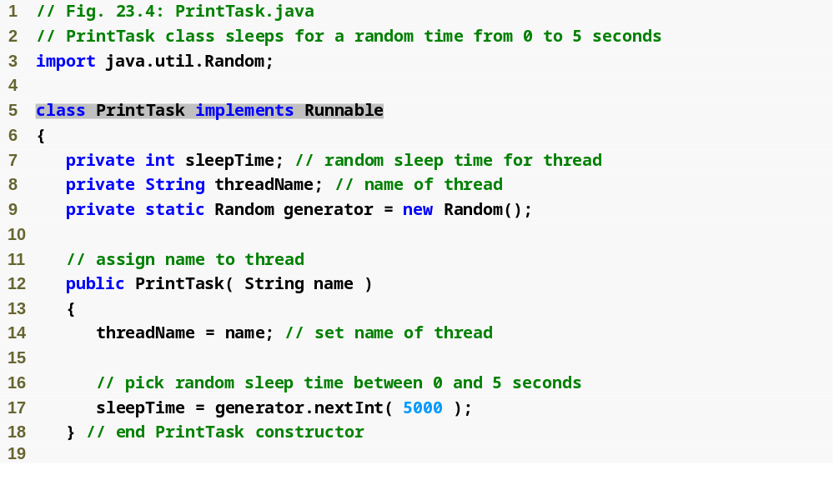
Outline
PrintTask.java
(1 of 2)
Implement runnable to create separate thread

Slide 21
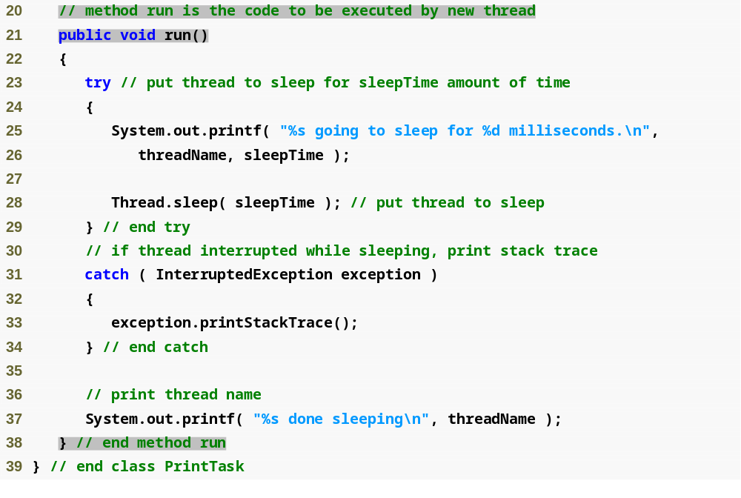
Outline
Declare run method to fulfill interface
PrintTask.java
(2 of 2)

Slide 22
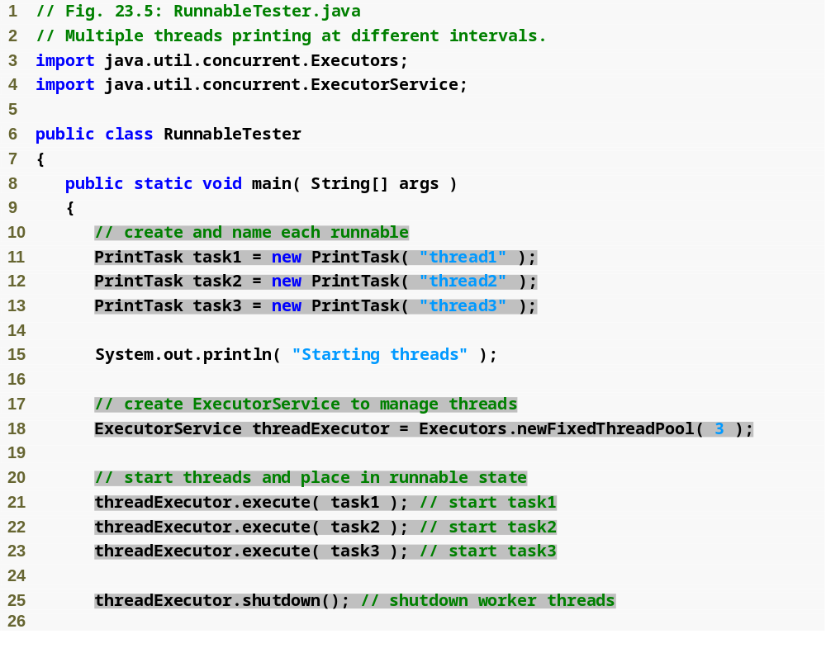
Outline
RunnableTester
.java
(1 of 2)
Create three PrintTasks; each will run in a separate thread
Create fixed thread pool to execute and manage threads
Execute each task; this method will assign a thread to the runnable
Shutdown thread pool when runnables complete their tasks

Slide 23
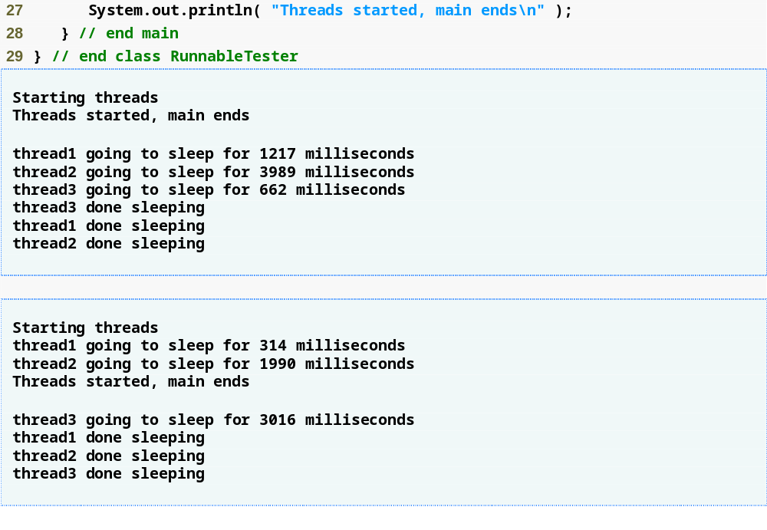
Outline
RunnableTester
.java
(2 of 2)

Slide 24
23.5 Thread Synchronization
Thread synchronization
  Provided to the programmer with mutual exclusion
    Exclusive access to a shared object
  Implemented in Java using locks
Lock interface
  lock method obtains the lock, enforcing mutual exclusion
  unlock method releases the lock
  Class ReentrantLock implements the Lock interface

Slide 25
Performance Tip 23.2
Using a Lock with a fairness policy helps avoid indefinite postponement, but can also dramatically reduce the overall efficiency of a program. Because of the large decrease in performance, fair locks are only necessary in extreme circumstances.

Slide 26
23.5 Thread Synchronization
Condition variables
  If a thread holding the lock cannot continue with its task until a condition is satisfied, the thread can wait on a condition variable
  Create by calling Lock method newCondition
  Represented by an object that implements the Condition interface
Condition interface
  Declares methods await, to make a thread wait, signal, to wake up a waiting thread, and signalAll, to wake up all waiting threads

Slide 27
Common Programming Error 23.1
Deadlock occurs when a waiting thread (let us call this thread1) cannot proceed because it is waiting (either directly or indirectly) for another thread (let us call this thread2) to proceed, while simultaneously thread2 cannot proceed because it is waiting (either directly or indirectly) for thread1 to proceed. Two threads are waiting for each other, so the actions that would enable each thread to continue execution never occur.

Slide 28
Error-Prevention Tip 23.1
When multiple threads manipulate a shared object using locks, ensure that if one thread calls method await to enter the waiting state for a condition variable, a separate thread eventually will call Condition method signal to transition the thread waiting on the condition variable back to the runnable state. (cont...)

Slide 29
Error-Prevention Tip 23.1
If multiple threads may be waiting on the condition variable, a separate thread can call Condition method signalAll as a safeguard to ensure that all the waiting threads have another opportunity to perform their tasks. If this is not done, indefinite postponement or deadlock could occur.

Slide 30
Software Engineering Observation 23.1
The locking that occurs with the execution of the lock and unlock methods could lead to deadlock if the locks are never released. Calls to method unlock should be placed in finally blocks to ensure that locks are released and avoid these kinds of deadlocks.

Slide 31
Performance Tip 23.3
Synchronization to achieve correctness in multithreaded programs can make programs run more slowly, as a result of thread overhead and the frequent transition of threads between the waiting and runnable states. There is not much to say, however, for highly efficient yet incorrect multithreaded programs!

Slide 32
Common Programming Error 23.2
It is an error if a thread issues an await, a signal, or a signalAll on a condition variable without having acquired the lock for that condition variable. This causes an IllegalMonitorStateException.

Slide 33
23.6 Producer/Consumer Relationship without Synchronization
Producer/consumer relationship
  Producer generates data and stores it in shared memory
  Consumer reads data from shared memory
  Shared memory is called the buffer

Slide 34
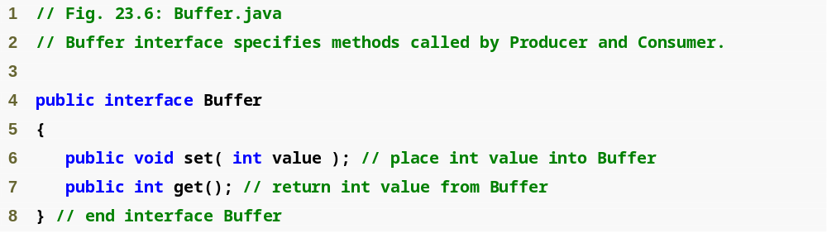
Outline
Buffer.java
Fig. 23.6 |Buffer interface used in producer/consumer examples.

Slide 35
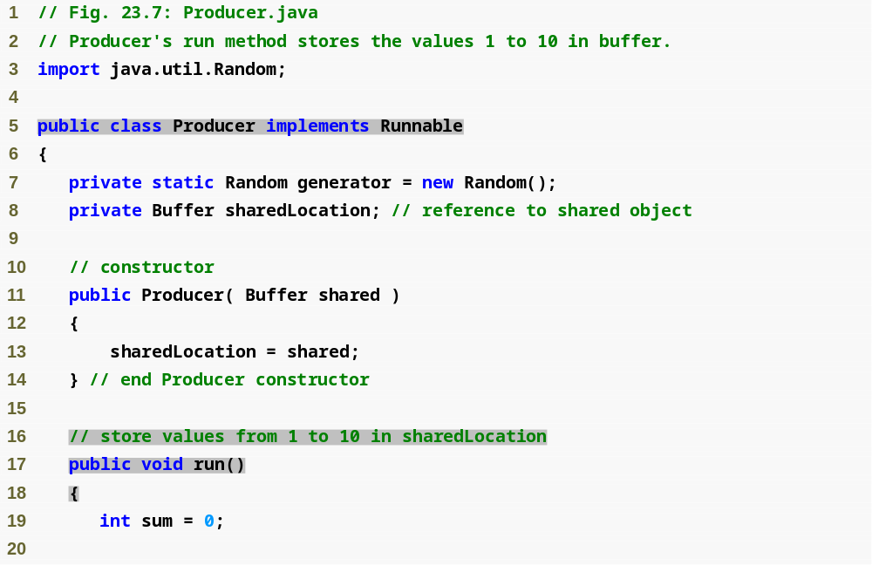
Outline
Producer.java
(1 of 2)
Implement the runnable interface so that producer will run in a separate thread
Declare run method to satisfy interface

Slide 36
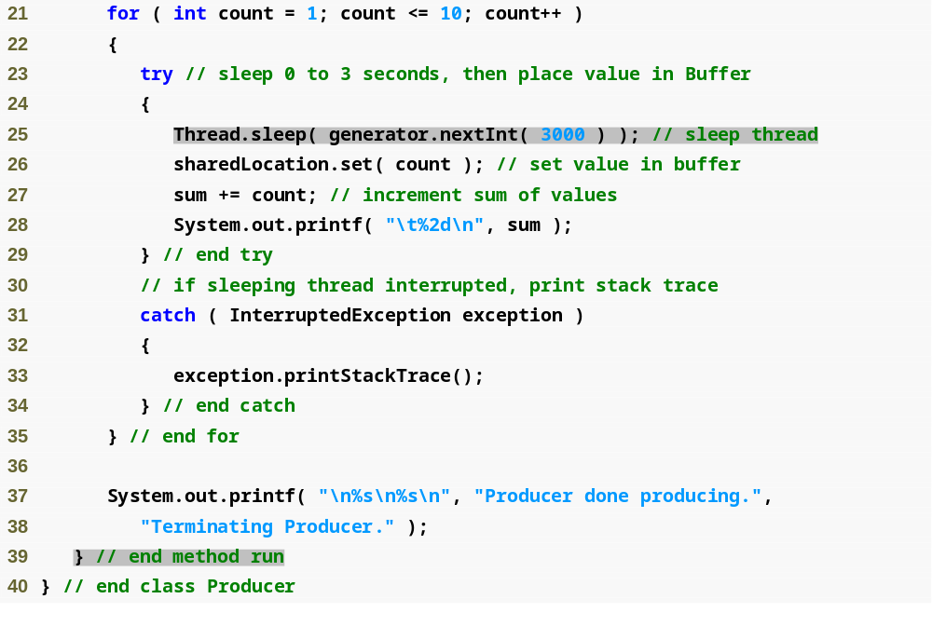
Outline
Producer.java
(2 of 2)
Sleep for up to 3 seconds

Slide 37
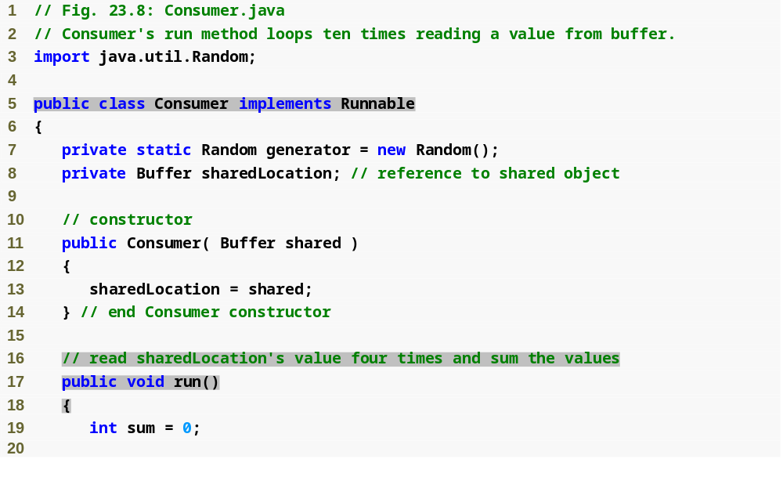
Outline
Consumer.java
(1 of 2)
Implement the runnable interface so that producer will run in a separate thread
Declare run method to satisfy interface

Slide 38
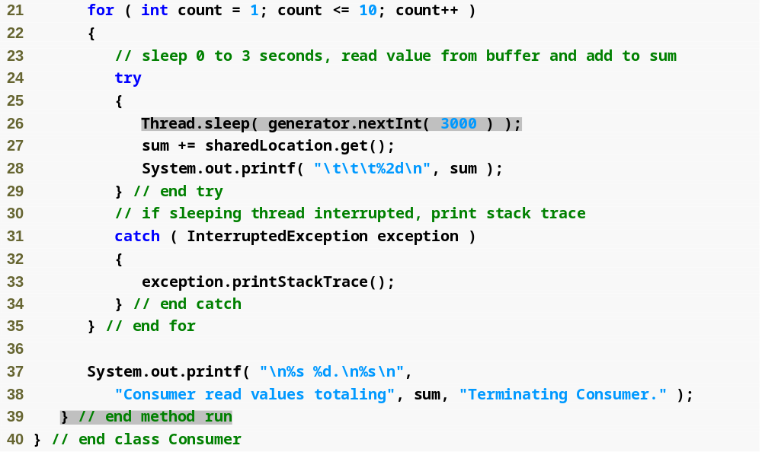
Outline
Consumer.java
(2 of 2)
Sleep for up to 3 seconds

Slide 39
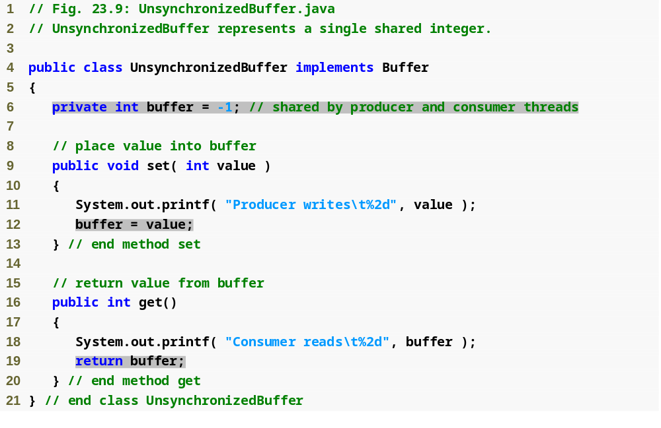
Outline
Unsynchronized
Buffer.java
Shared variable to store data
Set the value of the buffer
Read the value of the buffer

Slide 40
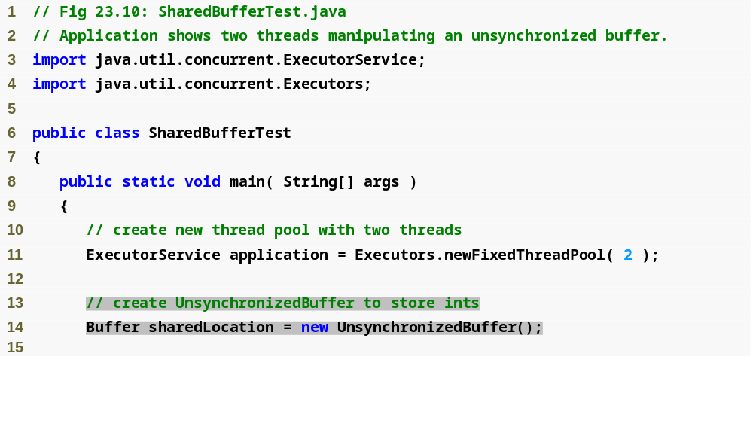
Outline
SharedBufferTest
.java
(1 of 4)
Create shared UnsynchronizedBuffer for producer and consumer to use

Slide 41
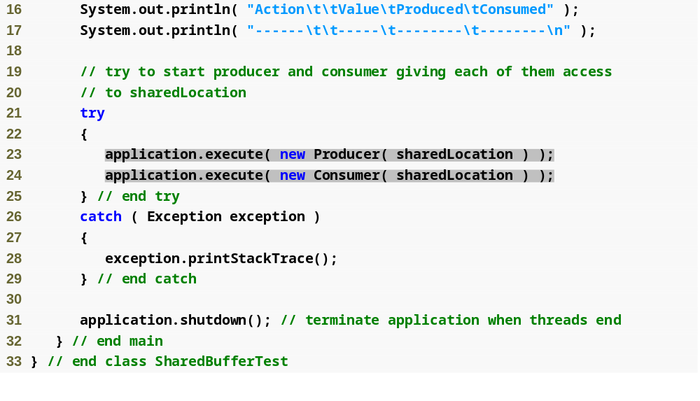
Outline
SharedBufferTest
.java
(2 of 4)
Pass shared buffer to both producer and consumer

Slide 42
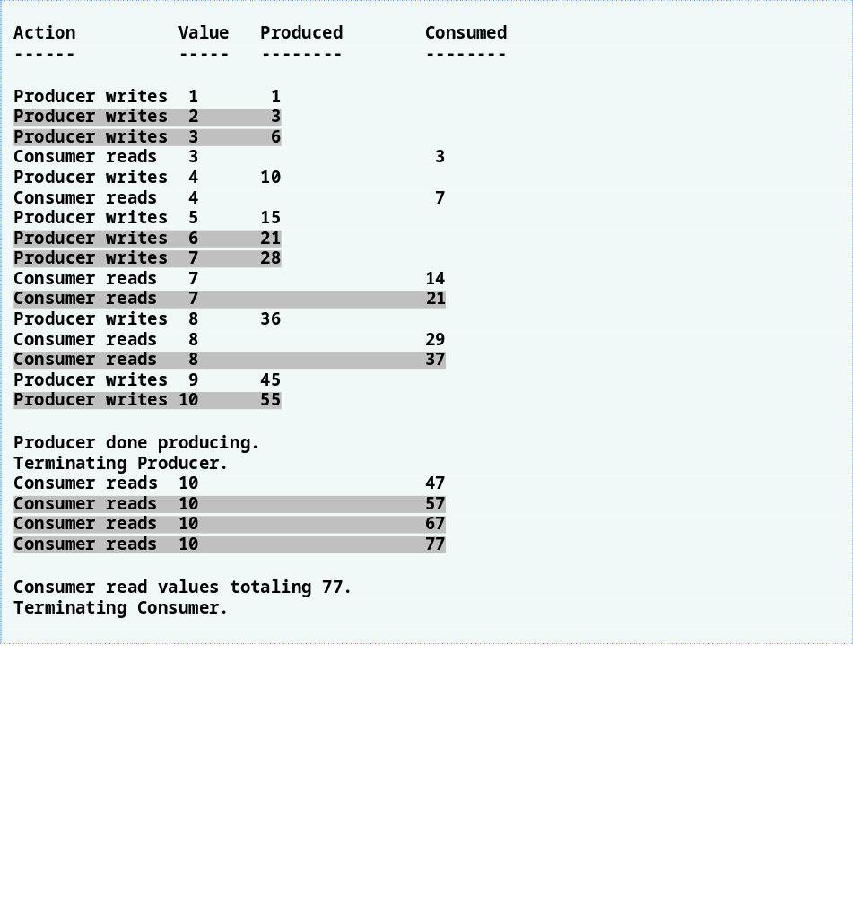
Outline
SharedBufferTest
.java
(3 of 4)

Slide 43
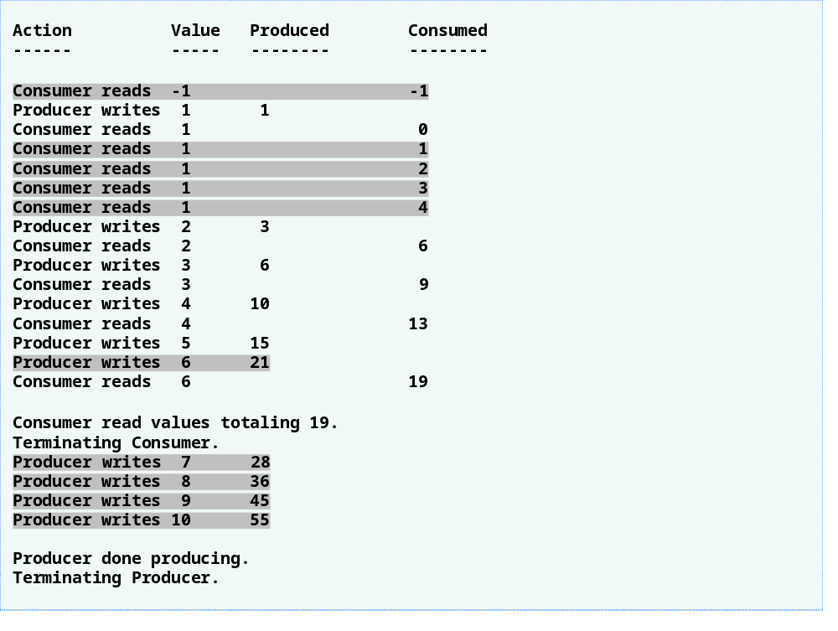
Outline
SharedBufferTest
.java
(4 of 4)

Slide 44
23.7 Producer/Consumer Relationship with Synchronization
Producer/consumer relationship
  This example uses Locks and Conditions to implement synchronization

Slide 45
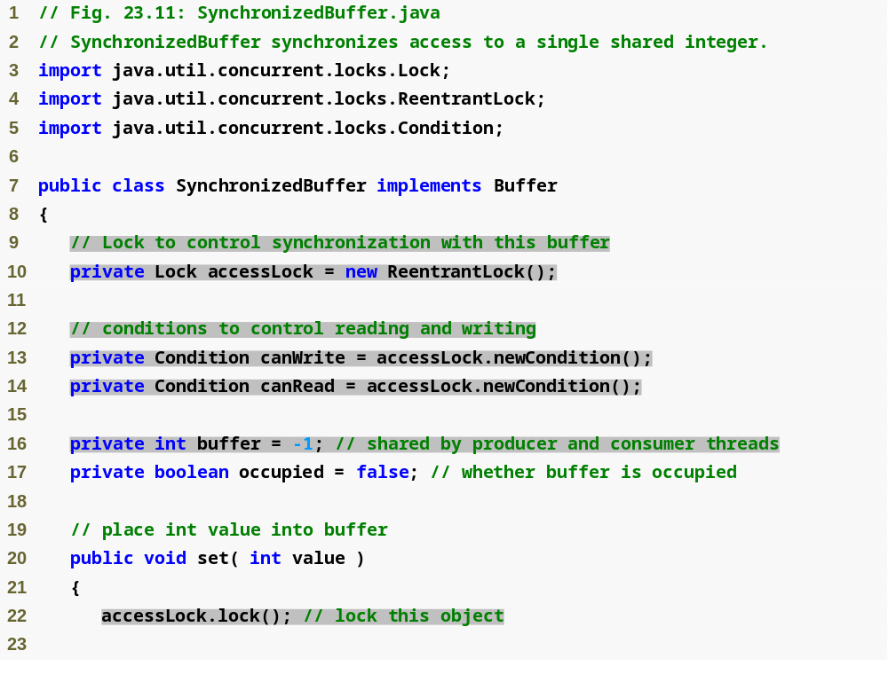
Outline
Create ReentrantLock for mutual exclusion
SynchronizedBuffer
.java
(1 of 5)
Create two Condition variables; one for writing and one for reading
Buffer shared by producer and consumer
Try to obtain the lock before setting the value of the shared data

Slide 46
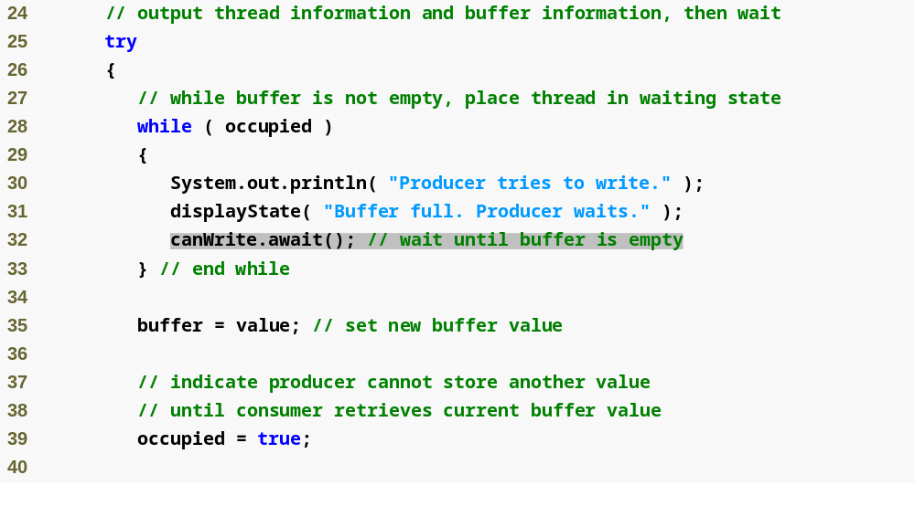
Outline
SynchronizedBuffer
.java
(2 of 5)
Producer waits until buffer is empty

Slide 47
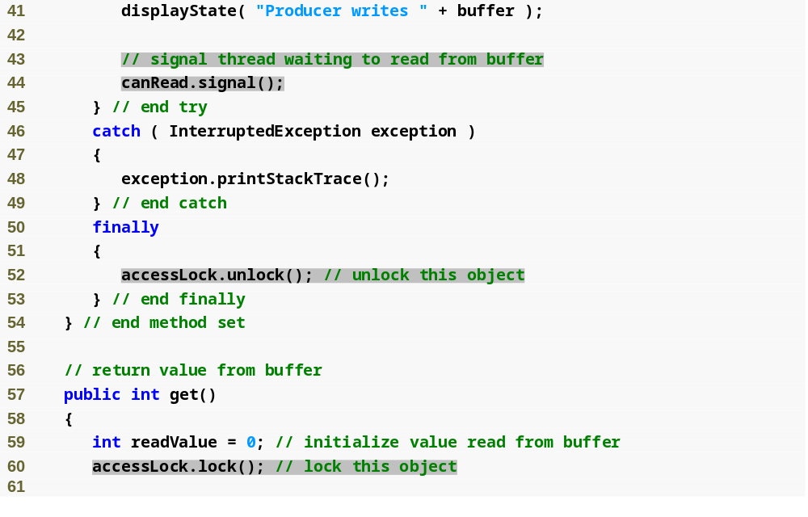
Outline
Signal consumer that it may read a value
SynchronizedBuffer
.java
(3 of 5)
Release lock on shared data
Acquire lock before reading a value

Slide 48
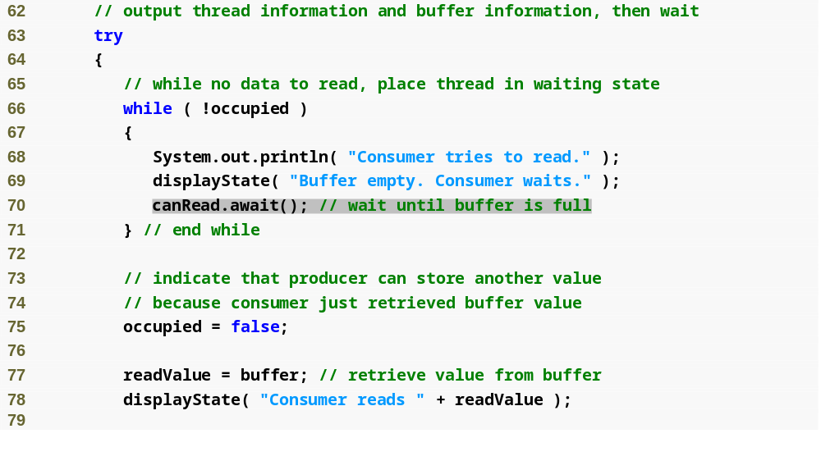
Outline
SynchronizedBuffer
.java
(4 of 5)
Consumer waits until buffer contains data to read

Slide 49
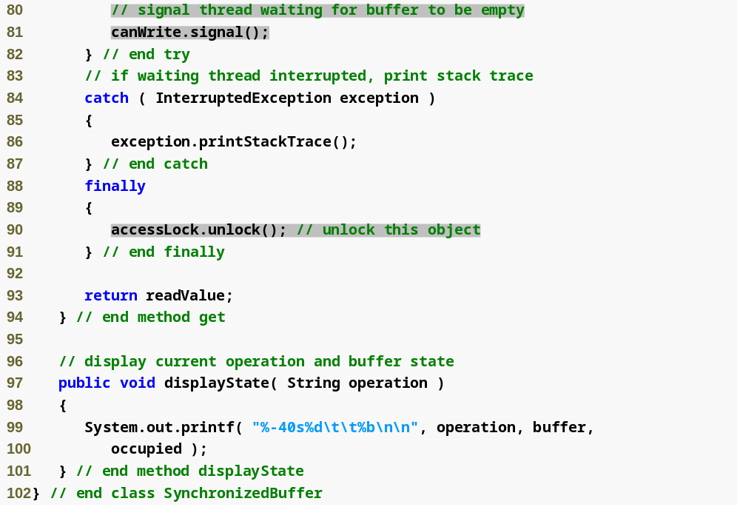
Outline
Signal producer that it can write to buffer
SynchronizedBuffer
.java
(5 of 5)
Release lock on shared data

Slide 50
Common Programming Error 23.3
Place calls to Lock method unlock in a finally block. If an exception is thrown, unlock must still be called or deadlock could occur.

Slide 51
Software Engineering Observation 23.2
Always invoke method await in a loop that tests an appropriate condition. It is possible that a thread will reenter the runnable state before the condition it was waiting on is satisfied. Testing the condition again ensures that the thread will not erroneously execute if it was signaled early.

Slide 52
Common Programming Error 23.4
Forgetting to signal a thread that is waiting for a condition is a logic error. The thread will remain in the waiting state, which will prevent the thread from doing any further work. Such waiting can lead to indefinite postponement or deadlock.

Slide 53
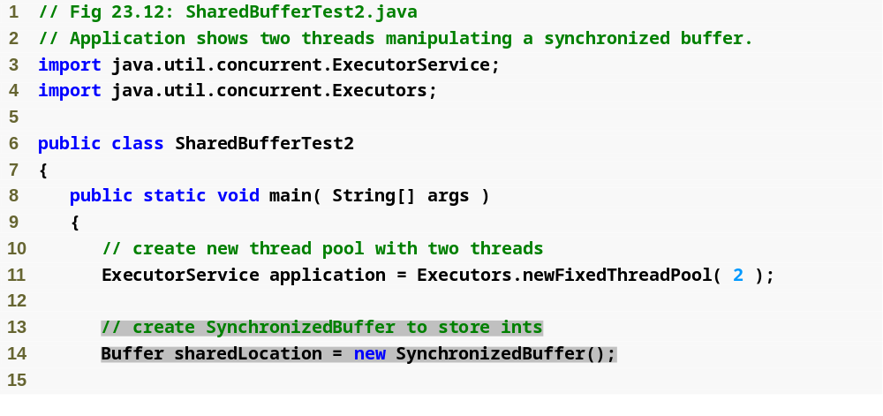
Outline
SharedBufferTest2
.java
(1 of 4)
Create SynchronizedBuffer to be shared between producer and consumer

Slide 54
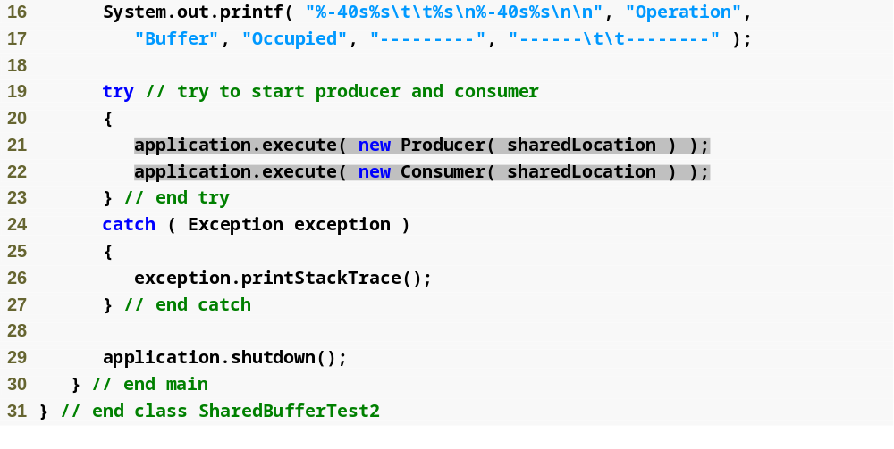
Outline
SharedBufferTest2
.java
(2 of 4)
Execute the producer and consumer in separate threads

Slide 55
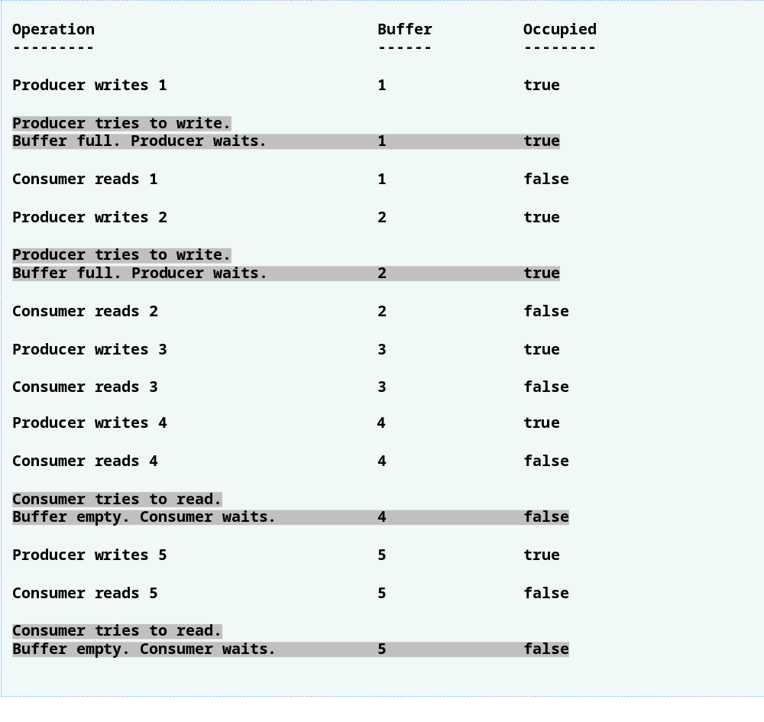
Outline
SharedBufferTest2
.java
(3 of 4)

Slide 56
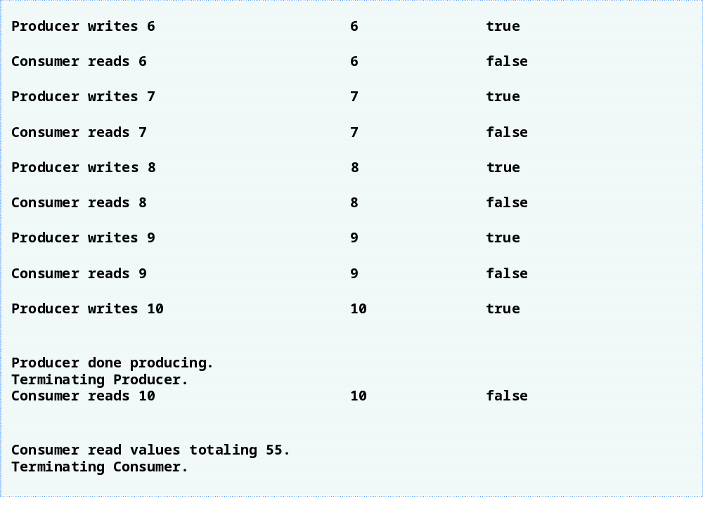
Outline
SharedBufferTest2
.java
(4 of 4)

Slide 57
23.8 Producer/Consumer Relationship Circular Buffer
Circular buffer
  Provides extra buffer space into which producer can place values and consumer can read values

Slide 58
Performance Tip 23.4
Even when using a circular buffer, it is possible that a producer thread could fill the buffer, which would force the producer thread to wait until a consumer consumes a value to free an element in the buffer. Similarly, if the buffer is empty at any given time, the consumer thread must wait until the producer produces another value. The key to using a circular buffer is to optimize the buffer size to minimize the amount of thread wait time.

Slide 59
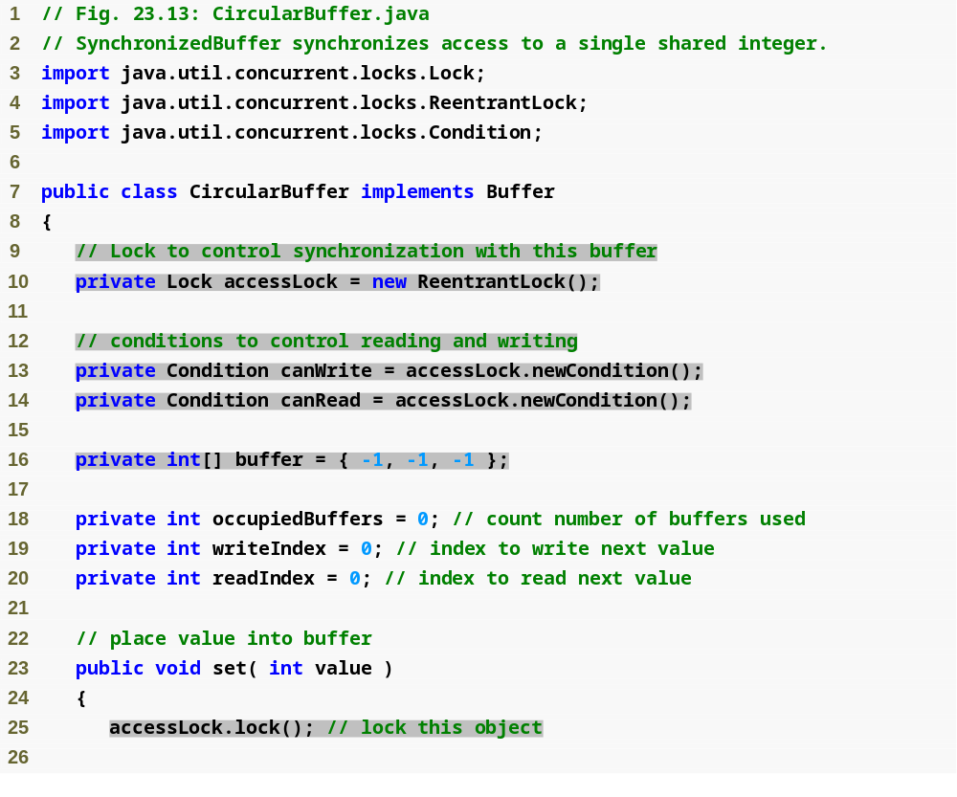
Outline
CircularBuffer
.java
(1 of 5)
Lock to impose mutual exclusion
Condition variables to control writing and reading
Circular buffer; provides three spaces for data
Obtain the lock before writing data to the circular buffer

Slide 60
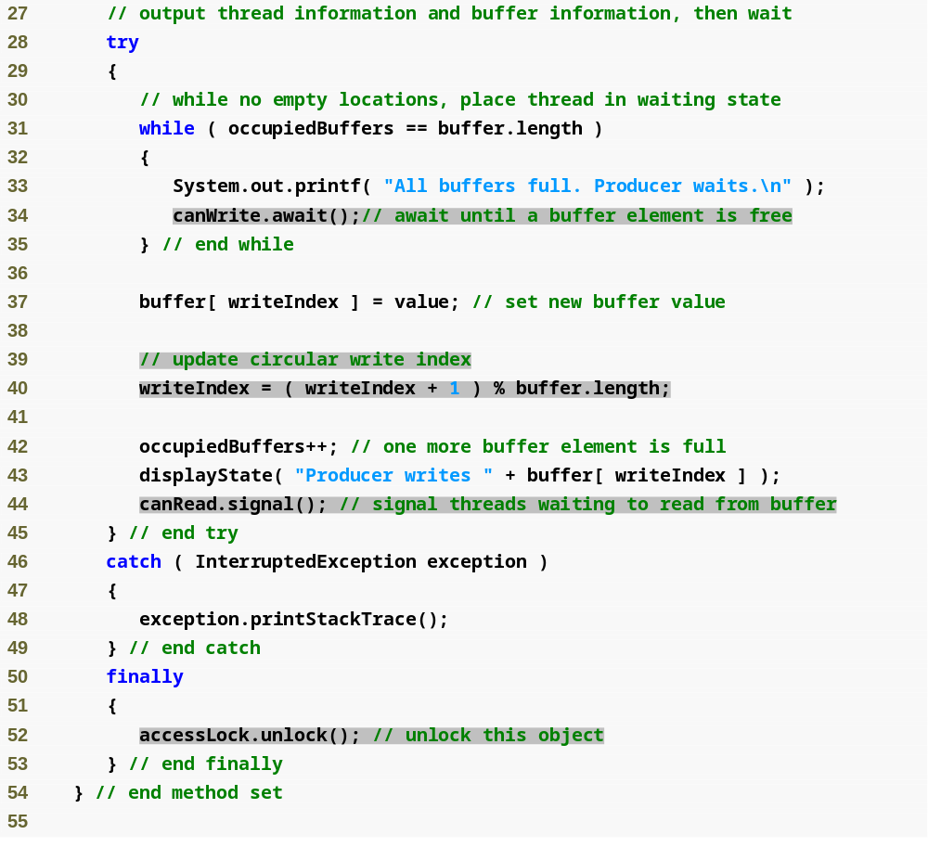
Outline
CircularBuffer
.java
(2 of 5)
Wait until a buffer space is empty
Update index; this statement imposes the circularity of the buffer
Signal waiting thread it can now read data from buffer
Release the lock

Slide 61
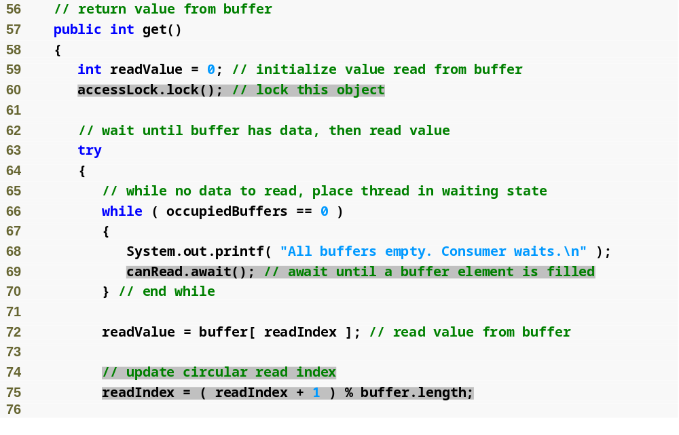
Outline
Lock the object before attempting to read a value
CircularBuffer
.java
(3 of 5)
Wait for a value to be written to the buffer
Update read index; this statement imposes the circularity of the buffer

Slide 62
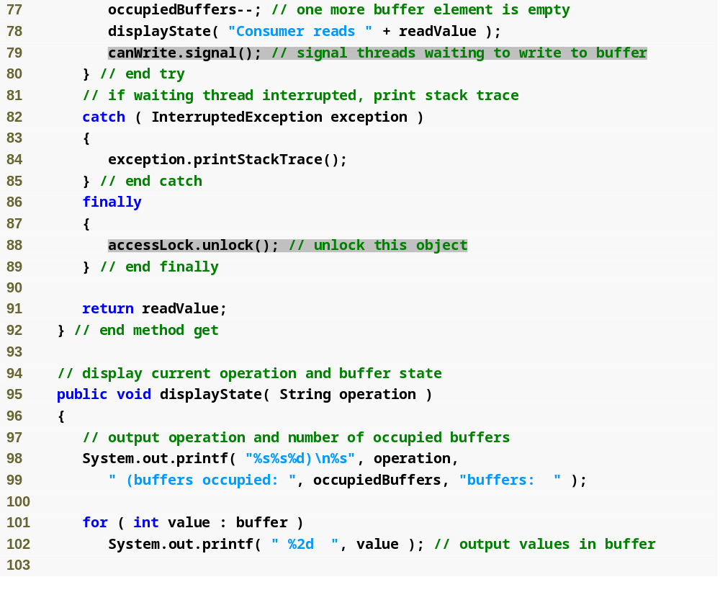
Outline
Signal thread waiting to write to the buffer
CircularBuffer
.java
(4 of 5)
Release the lock

Slide 63
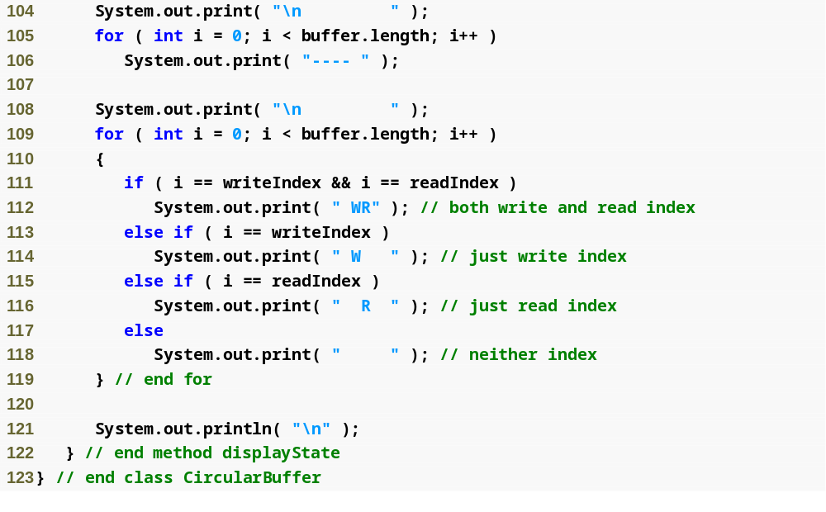
Outline
CircularBuffer
.java
(5 of 5)

Slide 64
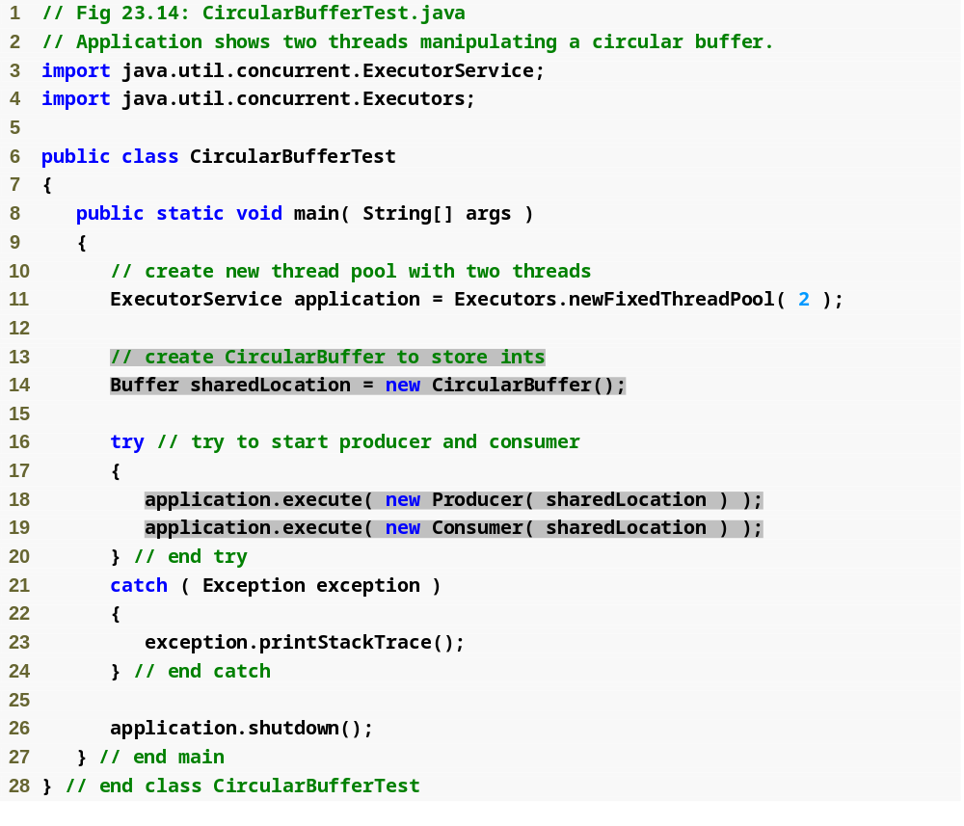
Outline
CircularBufferTest
.java
(1 of 4)
Create CircularBuffer for use in both the producer and consumer
Execute the producer and consumer in separate threads

Slide 65
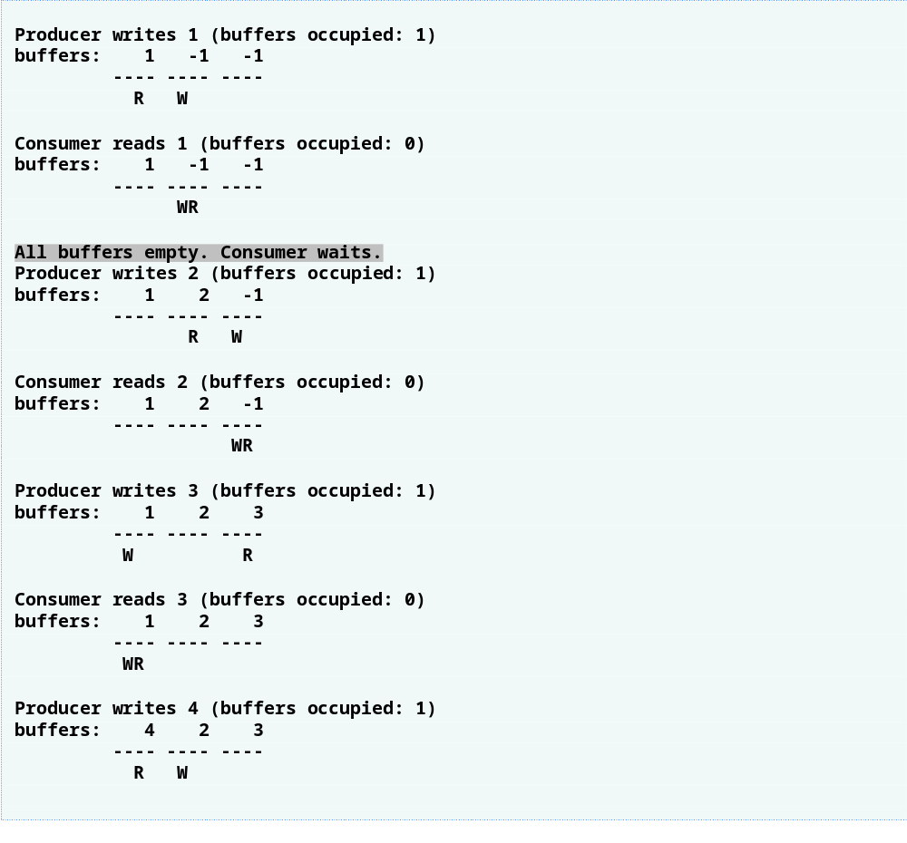
Outline
CircularBufferTest
.java
(2 of 4)

Slide 66
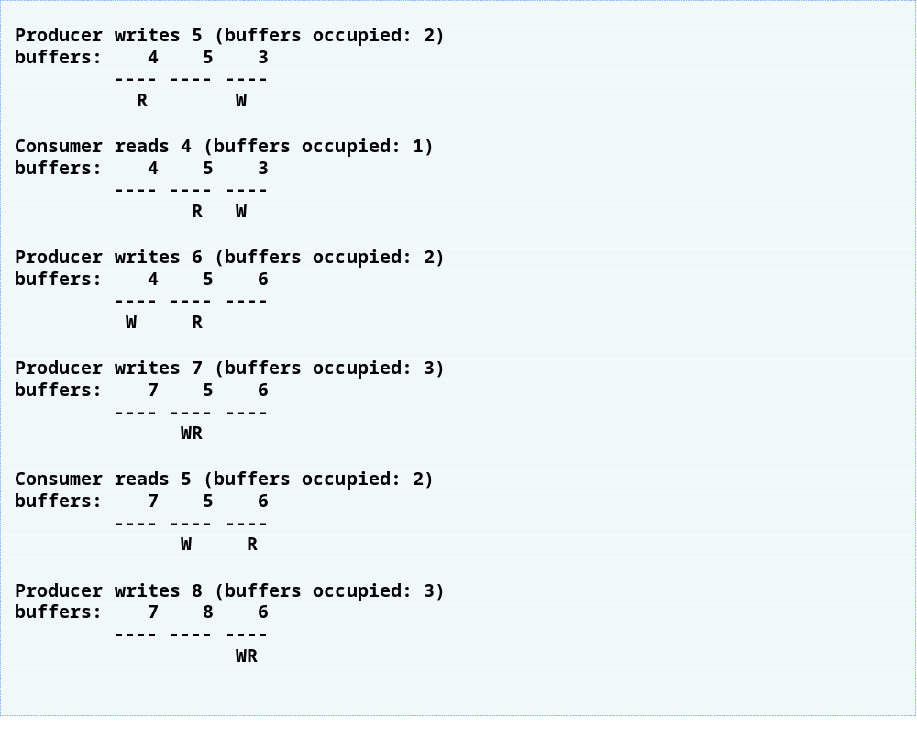
Outline
CircularBufferTest
.java
(3 of 4)

Slide 67
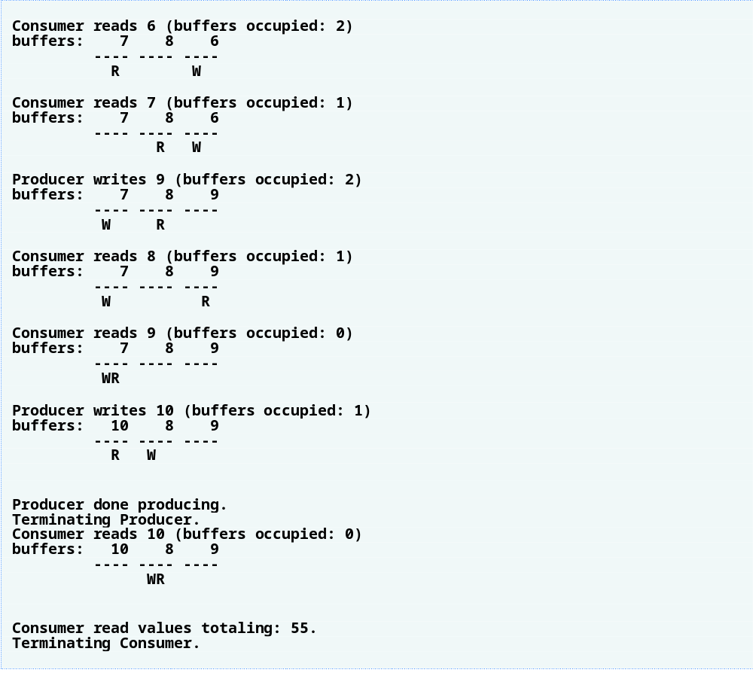
Outline
CircularBufferTest
.java
(4 of 4)

Slide 68
23.9 Producer/Consumer Relationship ArrayBlockingQueue
ArrayBlockingQueue
  Fully implemented version of the circular buffer
  Implements the BlockingQueue interface
  Declares methods put and take to write and read date from the buffer, respectively

Slide 69
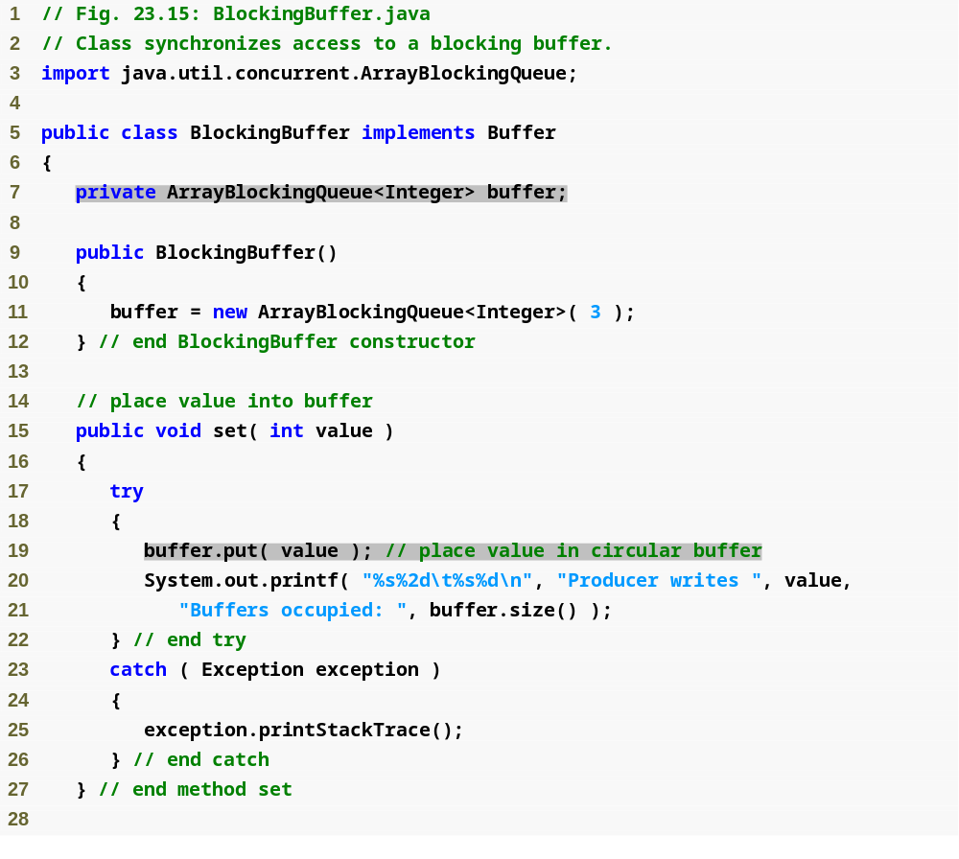
Outline
BlockingBuffer
.java
(1 of 2)
Create instance of ArrayBlockingQueue to store data
Place a value into the buffer; blocks if buffer is full

Slide 70
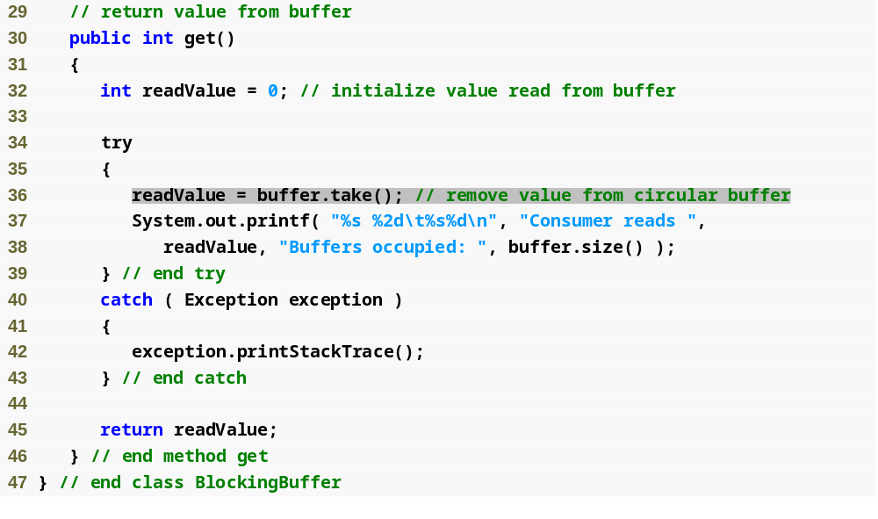
Outline
BlockingBuffer
.java
(2 of 2)
Remove value from buffer; blocks if buffer is empty

Slide 71
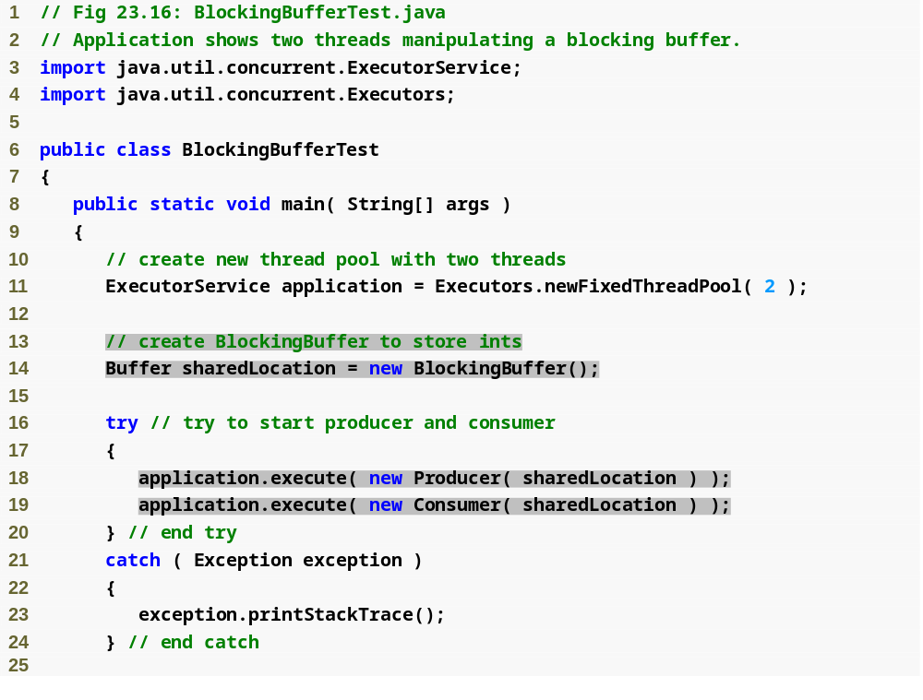
Outline
BlockingBufferTest
.java
(1 of 2)
Create BlockingBuffer for use in producer and consumer
Execute the producer and consumer in separate threads

Slide 72
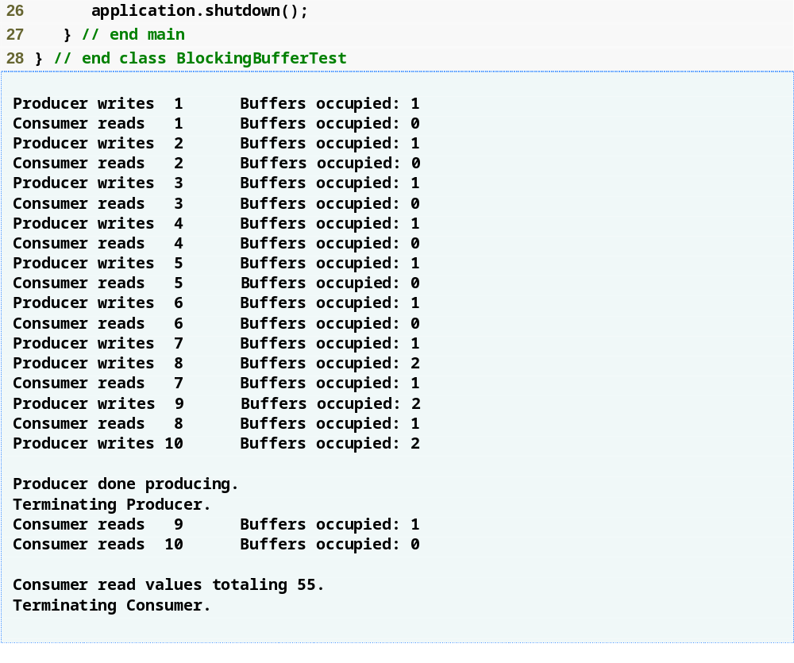
Outline
BlockingBufferTest
.java
(2 of 2)

Slide 73
23.10 Multithreading with GUI
Swing GUI components
  Not thread safe
  Updates should be performed in the event-dispatching thread
    Use static method invokeLater of class SwingUtilities and pass it a Runnable object

Slide 74
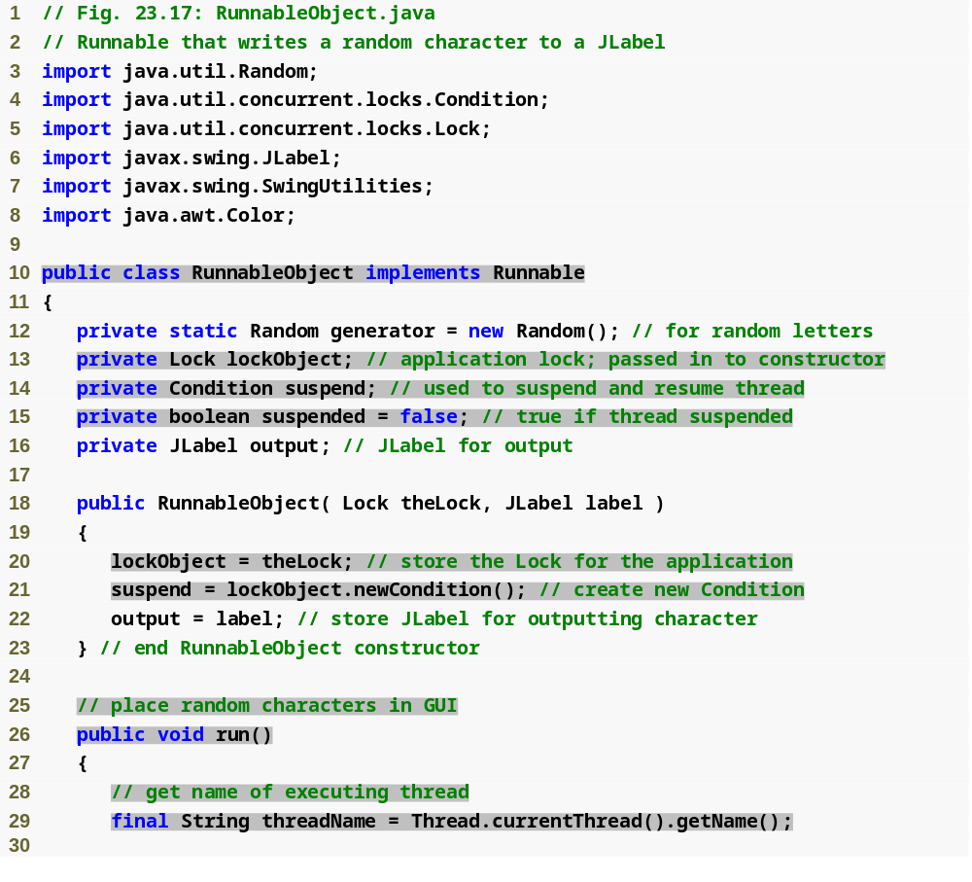
Outline
Implement the Runnable interface
RunnableObject
.java
(1 of 4)
Lock to implement mutual exclusion
Condition variable for suspending the threads
Boolean to control whether thread is suspended
Create the Lock and a Condition variable
Get name of current thread

Slide 75
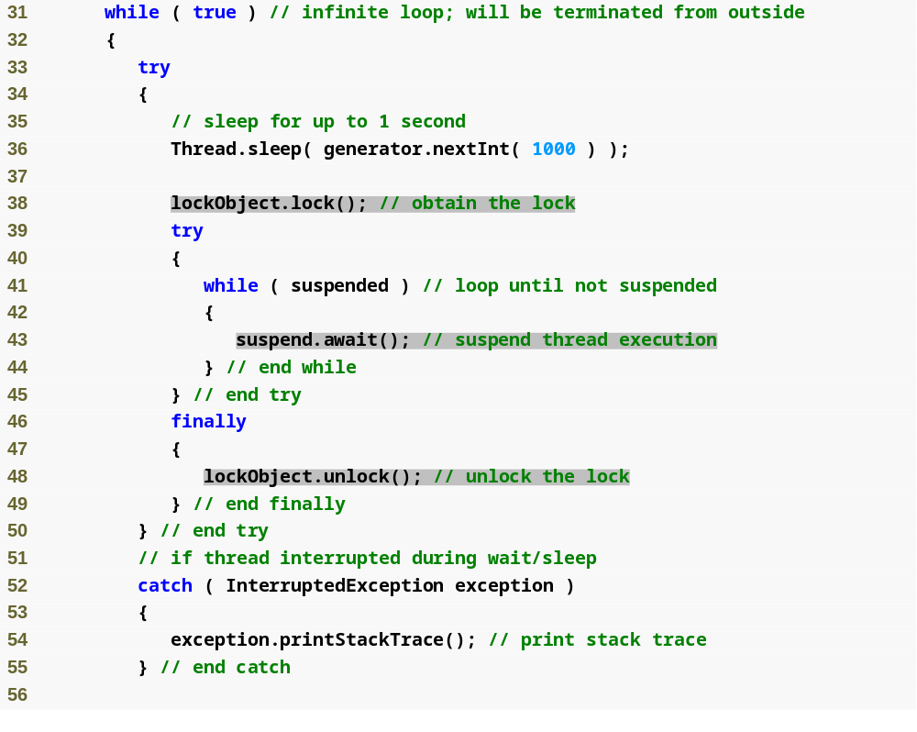
Outline
Obtain the lock to impose mutual exclusion
RunnableObject
.java
(2 of 4)
Wait while thread is suspended
Release the lock

Slide 76
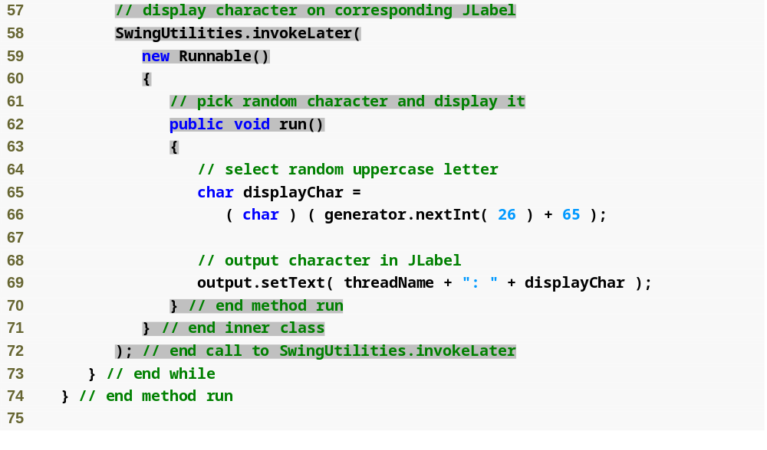
Outline
Call invokeLater
Method invokeLater is passed a Runnable
RunnableObject
.java
(3 of 4)

Slide 77
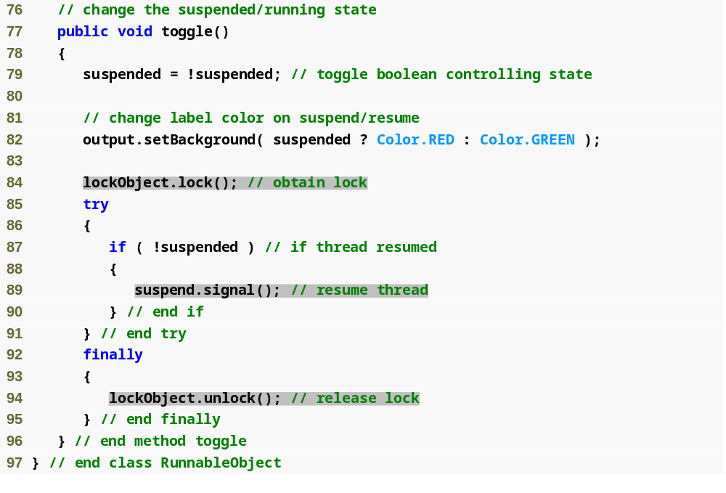
Outline
RunnableObject
.java
(4 of 4)
Obtain lock for the application
Resume a waiting thread
Release the lock

Slide 78
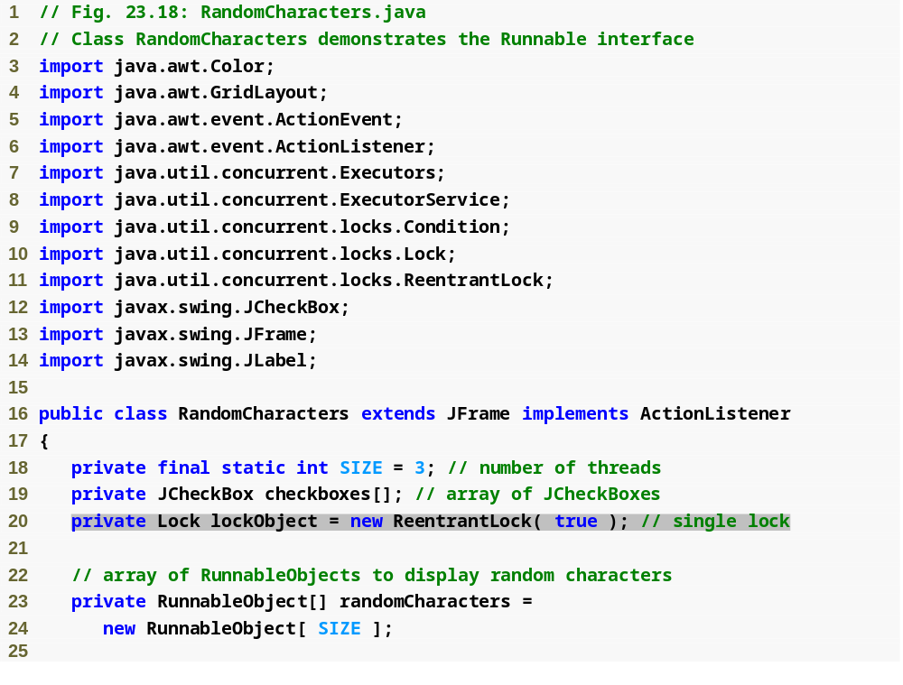
Outline
RandomCharacters
.java
(1 of 4)
Create Lock for the application

Slide 79
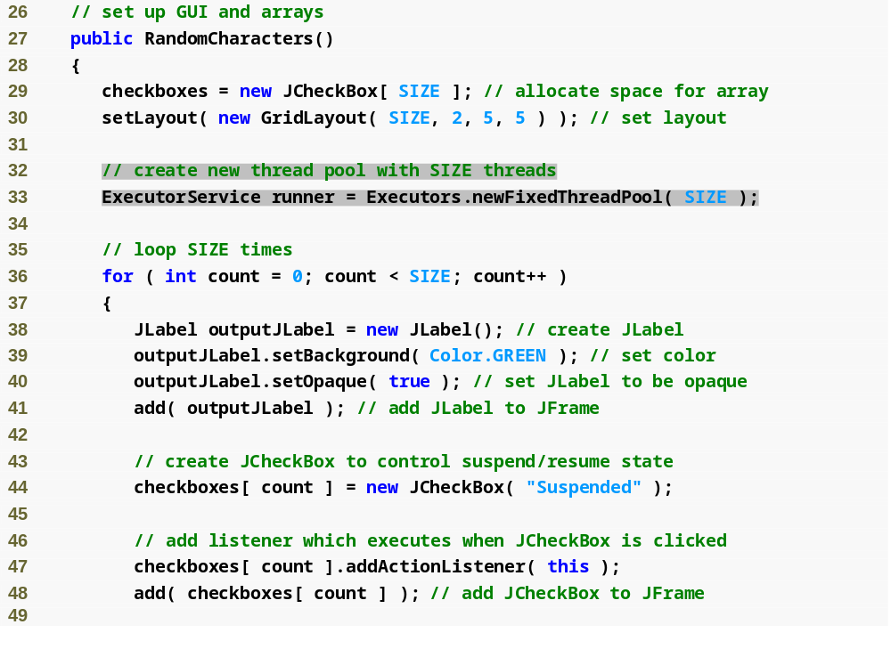
Outline
RandomCharacters
.java
(2 of 4)
Create thread pool for executing threads

Slide 80
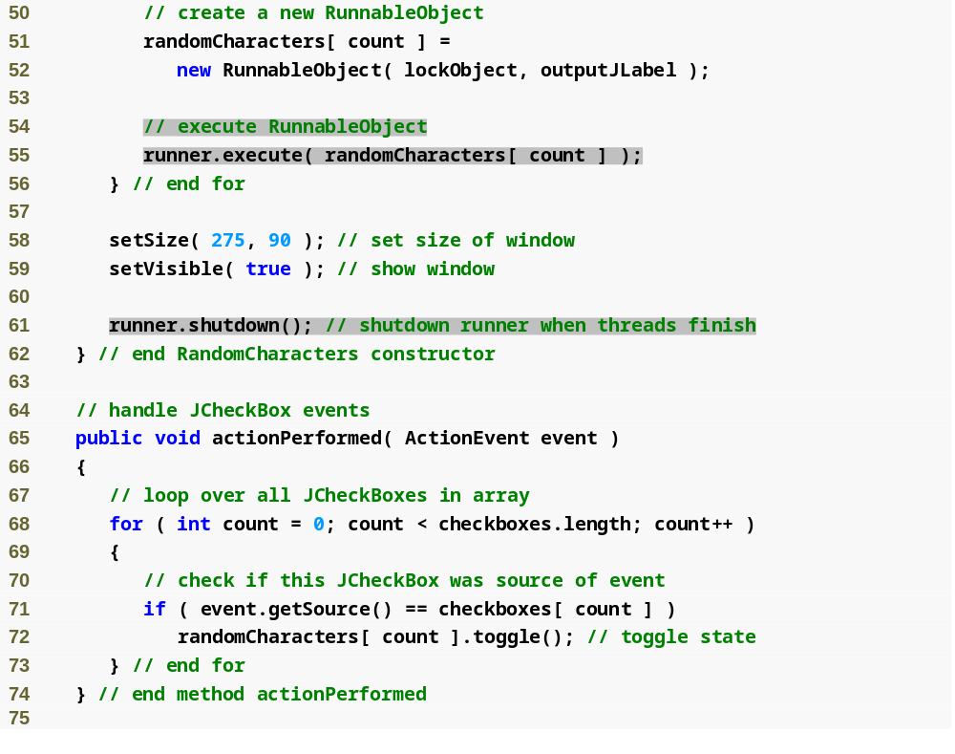
Outline
RandomCharacters
.java
(3 of 4)
Execute a Runnable
Shutdown thread pool when threads finish their tasks

Slide 81
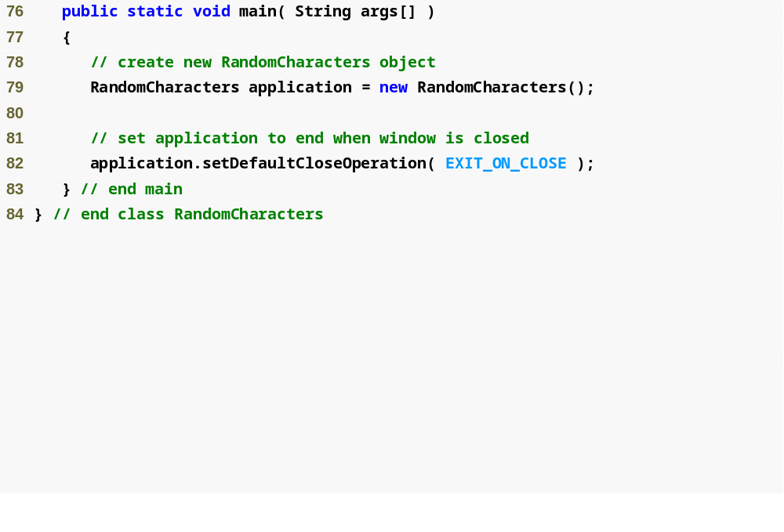


Outline
RandomCharacters
.java
(4 of 4)

Slide 82
23.11 Other Classes and Interfaces in java.util.concurrent
Callable interface
  Declares method call
  Method call allows a concurrent task to return a value or throw an exception
  ExecutorService method submit takes a Callable and returns a Future representing the result of the task
Future interface
  Declares method get
  Method get returns the result of the task represented by the Future

Slide 83
23.12 Monitors and Monitor Locks
Monitors
  Every object in Java has a monitor
  Allows one thread at a time to execute inside a synchronized statement
  Threads waiting to acquire the monitor lock are placed in the blocked state
  Object method wait places a thread in the waiting state
  Object method notify wakes up a waiting thread
  Object method notifyAll wakes up all waiting threads

Slide 84
Software Engineering Observation 23.3
The locking that occurs with the execution of synchronized methods could lead to deadlock if the locks are never released. When exceptions occur, Java’s exception mechanism coordinates with Java’s synchronization mechanism to release locks and avoid these kinds of deadlocks.

Slide 85
Common Programming Error 23.5
It is an error if a thread issues a wait, a notify or a notifyAll on an object without having acquired a lock for it. This causes an IllegalMonitorStateException.

Slide 86
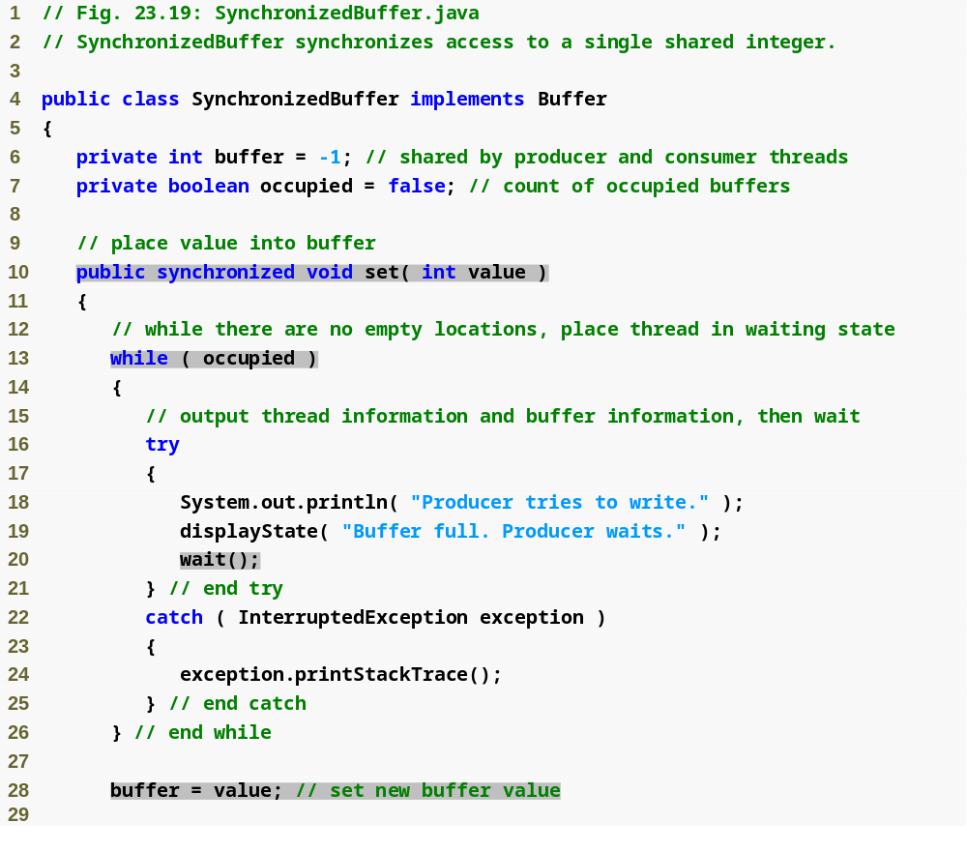
Outline
SynchronizedBuffer
.java
(1 of 3)
Declare a synchronized set method
Wait until buffer is empty
Set buffer value

Slide 87
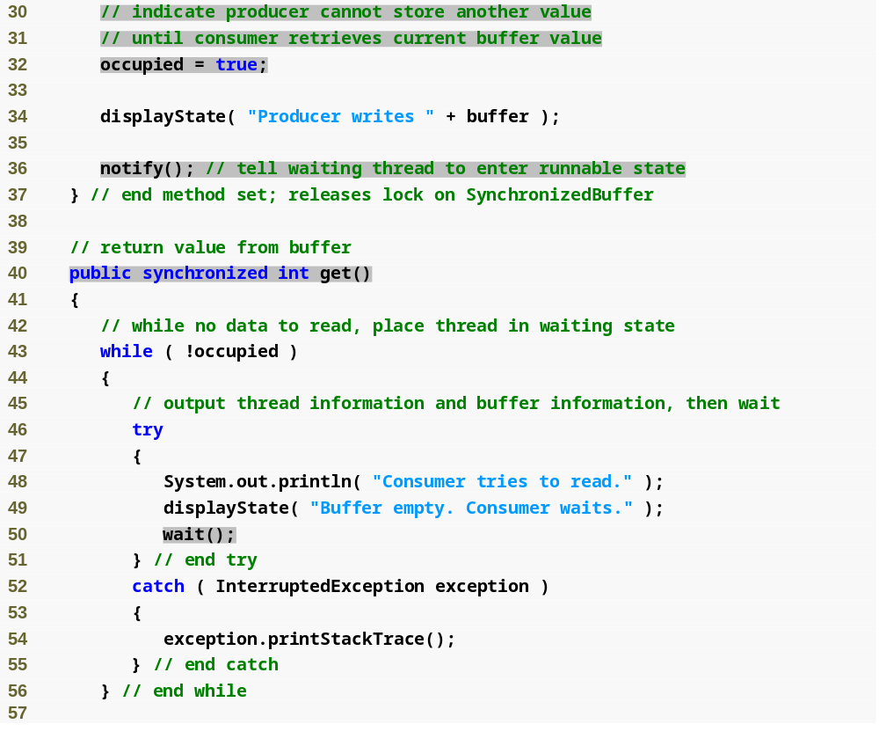
Outline
Buffer is now occupied
SynchronizedBuffer
.java
(2 of 3)
Notify waiting thread that it may now read a value
Declare synchronized get method
Wait until buffer is full

Slide 88
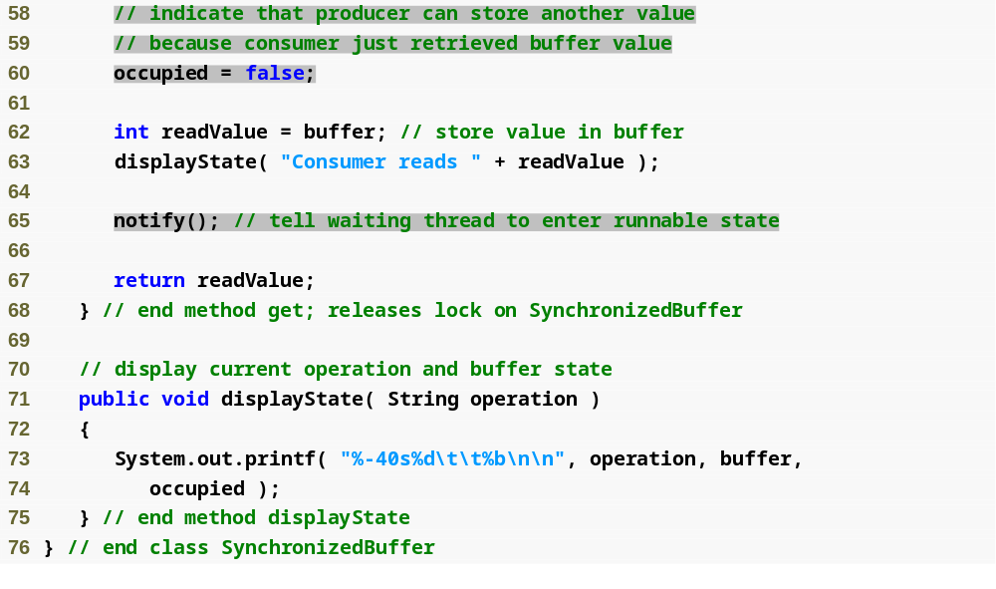
Outline
Buffer is now empty
SynchronizedBuffer
.java
(3 of 3)
Notify thread it may now write to buffer

Slide 89

Outline
SharedBufferTest2
.java
(1 of 3)
Create SynchronizedBuffer for use in producer and consumer
Execute the producer and consumer in separate threads

Slide 90

Outline
SynchronizedBuffer
.java
(2 of 3)

Slide 91

Outline
SynchronizedBuffer
.java
(3 of 3)

